Slide 1
TATA Group Data Visualisation Virtual Internship
Task 4: Communicating Insights and Analysis

Slide 2
Introduction
Hello Team,
I'm Charles Arulanandu, and I'm excited to share some insights about the business. Thank you for the guiding questions. I hope you find this analysis helpful for your future business decisions.

Slide 3
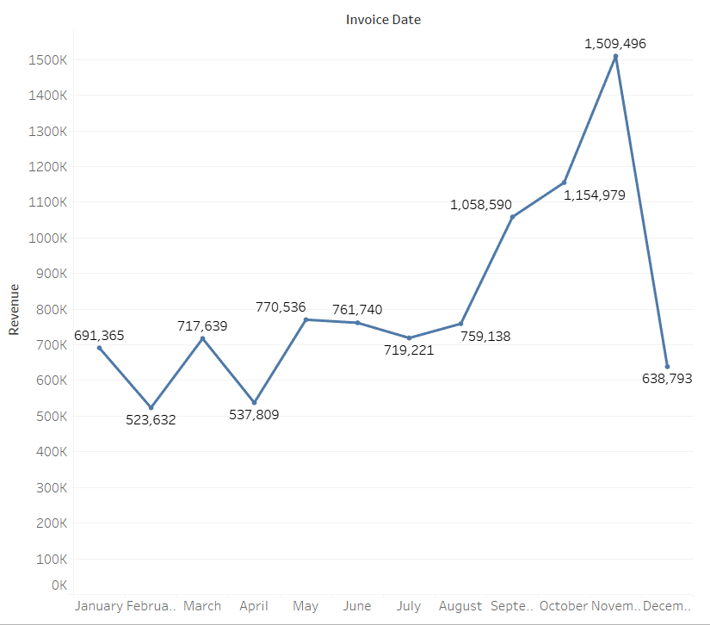
Revenue Trend Analysis
After cleaning the data, my analysis shows a clear seasonality in store sales. Revenue remains fairly constant at around $685k for the first 8 months. However, starting in September, there is a significant increase, peaking at 1.5 million USD in November. December's data is incomplete, so no conclusions can be drawn for that month.

Slide 4
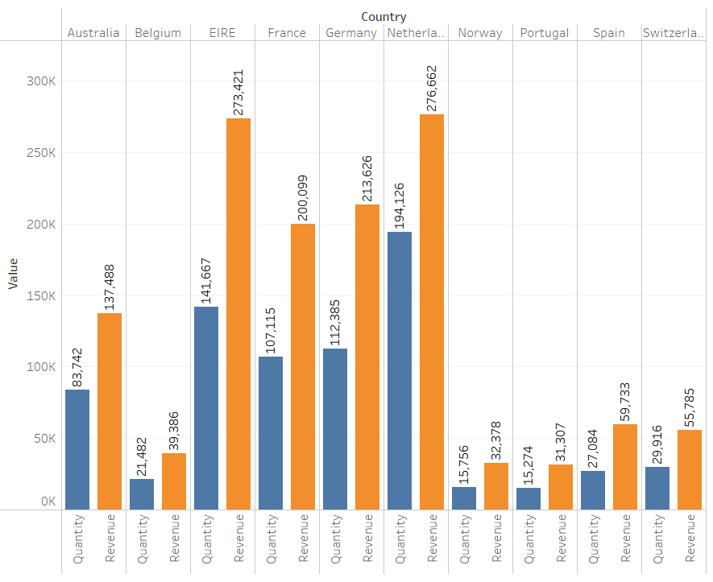
Top Performing Countries
Excluding the UK, which already has high demand, the top countries for potential growth are the Netherlands, Ireland, Germany, and France. These countries show high volumes of units bought and revenue generated.

Slide 5
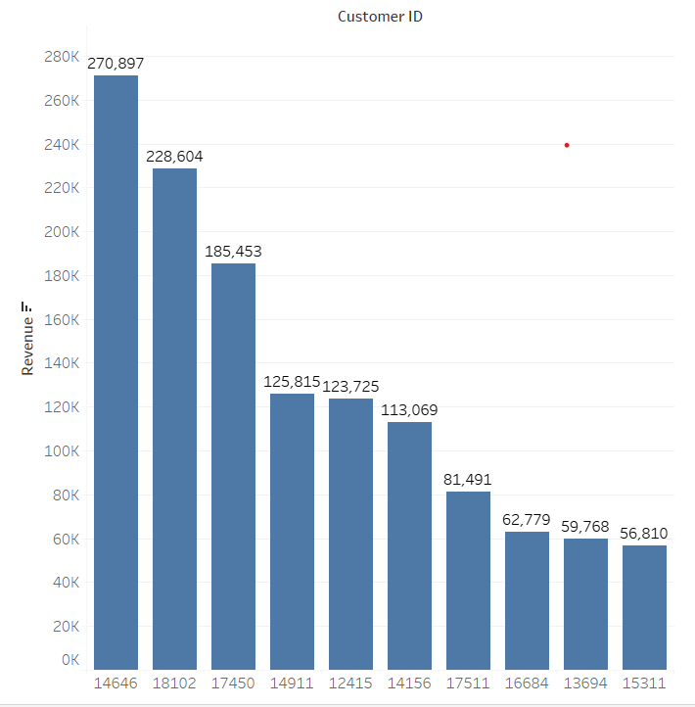
Top Customer Analysis
The top 10 customers contribute fairly evenly to revenue, with the highest spending customer only 17% ahead of the second highest. This indicates low customer bargaining power and a strong market position.

Slide 6
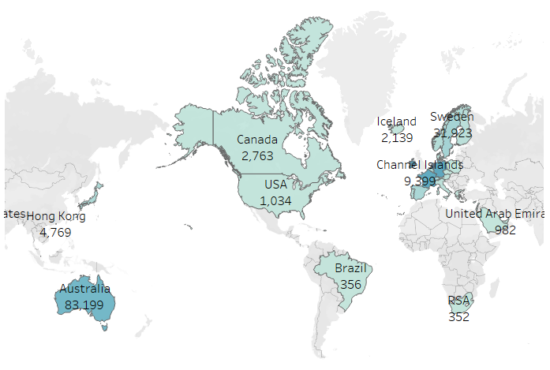
Revenue by Region
Apart from the UK, high revenue is generated from the Netherlands, Ireland, Germany, France, and Australia. Most sales are concentrated in Europe, with minimal sales in the Americas, Africa, and Asia. Targeting these untapped regions could boost sales and profitability.
Notes:
Thank you for your time. If you have any questions or need further analysis, please let me know.

Slide 7
Conclusion and Q&A
Thank you for your time. If you have any questions or need further analysis, please let me know.

